Slide 1
CRF with Viterbi decoding for Chunking
Under the Guidance of:
Dr. Anil Kumar Singh
Associate Professor
Department of Computer Science
Anuraj Singh(17074003)
Shivansh Saini(17075054)
Dipesh Kumar(17075021)

Slide 2
1.PROBLEM STATEMENT:
Perform the Conditional Random Field (CRF) with Viterbi decoding for sequential tagging (Chunking) by writing code using existing library for CRF.

Slide 3
1.1 BRIEF DESCRIPTION OF THE PROJECT:
Conditional Random Field (CRF) is a discriminative probabilistic algorithm, used for the sequence to sequence problems, unlike HMM (a generative probabilistic algorithm). In this task, the students explore the efficient pre-compiled library of CRF with Viterbi decoding to solve the Chunking problem for Hindi. CRF is a feature-based algorithm, so the student must submit the comparative result, which obtained from different feature sets for all the metric level.

Slide 4
2.INTRODUCTION:
Phrase chunking is a Natural Language Processing task that consists in dividing a text into syntactically correlated parts of words. Theses phrases are non-overlapping, i.e. a word can only be a member of one chunk.Chunking works on top of POS tagging, it uses pos-tags as input and provides chunks as output. Similar to POS tags, there are a standard set of Chunk tags like Noun Phrase(NP), Verb Phrase (VP), etc.
Conditional Random Fields (CRF)
Machine Learning models have two common categorizations, Generative and Discriminative. Conditional Random Fields are a type of Discriminative classifier, and as such, they model the decision boundary between the different classes. In CRFs, our input data is sequential, and we have to take previous context into account when making predictions on a data point.

Slide 5
3.RELATED WORK:
Most previous work used two main machine-learning approaches to sequence labeling. The first approach relies on k-order generative probabilistic models of paired input sequences and label sequences, for instance hidden Markov models (HMMs) (Freitag and McCallum, 2000). The second approach views the sequence labeling problem as a sequence of classification problems, one for each of the labels in the sequence. Previous work on Chunking for Hindi dataset had been done using CRF model (Himanshu, 2016).

Slide 6
4.DATASET INFORMATION:
Hindi Treebank data_IITH (POS Tagged Data).
Data in Shakti Standard Format(SSF).
SSF allows information in a sentence to be represented in a form of one or more trees.
Nodes of the trees are the set of attribute value pair.
Dataset size:50.8MB
Total sentences:21086

Slide 7
4.1 DATA SAMPLE:
<Sentence id='1'>
1 (( NP <fs name='NP' drel='k2:VGNF'>
1.1 बौद्ध NNP <fs af='बौद्ध', 'n', 'm', 'sg', '3', 'd', '0', "0' name='बौद्ध' posn='30">
1.2 तीर्थ NN <fs af='तीर्थ', 'n', 'm', 'sg', '3', 'd', '0', "0' name='तीर्थ' posn='20">
))
2 (( NP <fs voicetype='active' drel='ccof:CCP' stype='declarative' name='VGF2'>
2.1 कुशीनगर NNP <fs af='कुशीनगर', 'n', 'm', 'sg', '3', 'd', '0', "0' name='कुशीनगर' posn='30">
))
</Sentence>

Slide 8
5.PREPROCESSING:
Dataset is converted in IOB2 format. Here in this, each chunk is categorized by two prefixes B and I.
B-prefix means that tag marks the beginning of a chunk.
I-prefix means that the word is an internal part of the chunk.
O means the word is outside of any chunk in a sentence.

Slide 9
5.1 SAMPLE AFTER PREPROCESSING
[
{'word': 'बौद्ध', 'word_category': 'NNP', 'chunk_category': 'B-NP', 'morph_features': ['बौद्ध', 'n', 'm', 'sg', '3', 'd', '0', "0' name='बौद्ध' posn='30"]},
{'word': 'तीर्थ', 'word_category': 'NN', 'chunk_category': 'I-NP', 'morph_features': ['तीर्थ', 'n', 'm', 'sg', '3', 'd', '0', "0' name='तीर्थ' posn='20"]},
{'word': 'कुशीनगर', 'word_category': 'NNP', 'chunk_category': 'B-NP', 'morph_features': ['कुशीनगर', 'n', 'm', 'sg', '3', 'd', '0', "0' name='कुशीनगर' posn='30"]}
]

Slide 10
6. Feature Selection
All features available- {Word,POS Tag,bigram Features(POS Tag of Next Word, POS Tag of the Previous Word),Morphological Features(Gender,Number,Person,Case,Root Word),Word==RootWord}
Word, POS Tag and Bigram Features are Common for every feature set. Apart from them we choose the sets :
Mode 0 - {}
Mode 1 - { Gender }
Mode 2 - { Number }
Mode 3 - { Gender, Number }
Mode 8 - { Case }
Mode 11 - { Gender, Number, Case }
Mode 16 - { Root Word, Word==RootWord }
Mode 24 - { Case, RootWord, Word==RootWord }

Slide 11
7. Model
Model Name: Conditional Random Fields(CRF)
Library Used: sklearn_crfsuite
Based on discriminative model
Uses Conditional Probability Distribution
Works better than generative model ( because generative models require stringent assumptions)

Slide 12
8. Results & Analysis
Mode F1 Score
0 0.974332
1 0.974210
2 0.974696
3 0.974474
8 0.975352
11 0.975402
16 0.974329
24 0.975210
Analysis are done on the following levels:
Data Level, POS Tag Level, Word Level, Sentence Level

Slide 13
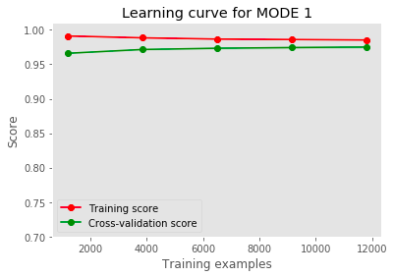
8.1 Data-level analysis
Learning Curve Graph

Slide 14
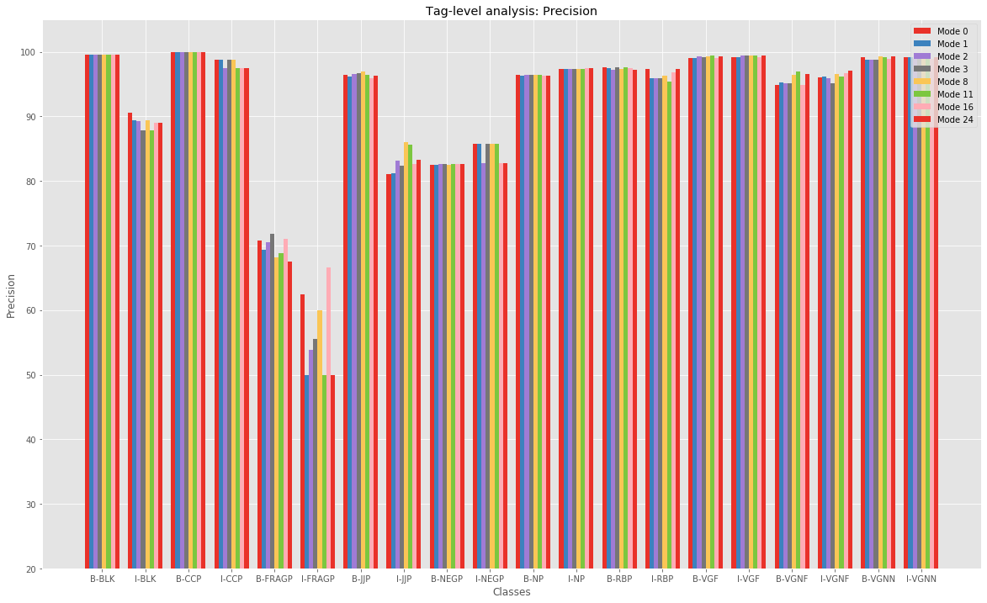
8.2 POS Tag Level Analysis

Slide 15
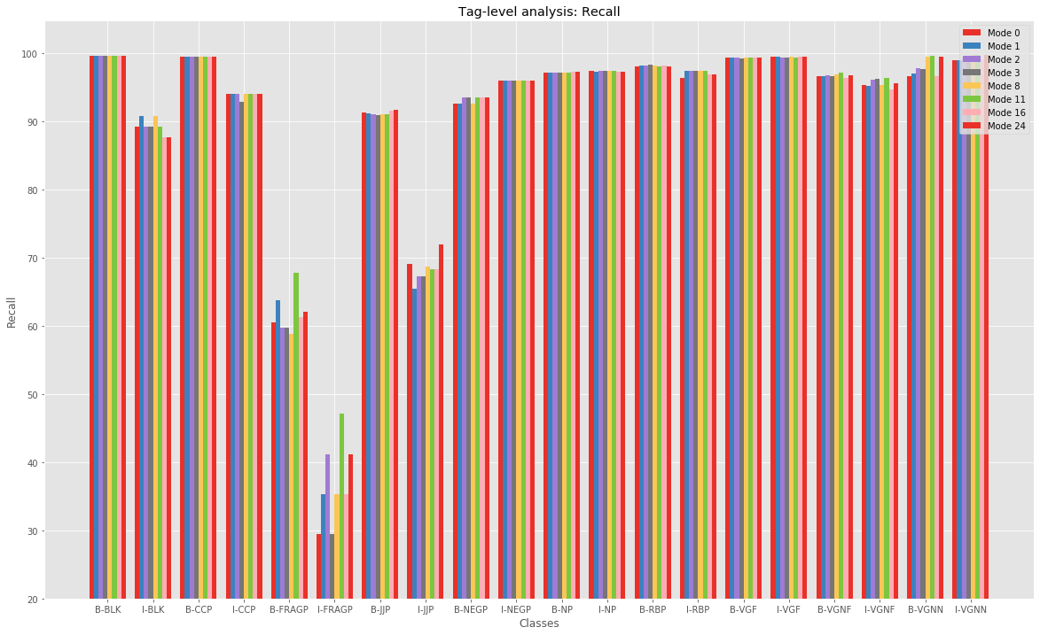

Slide 16
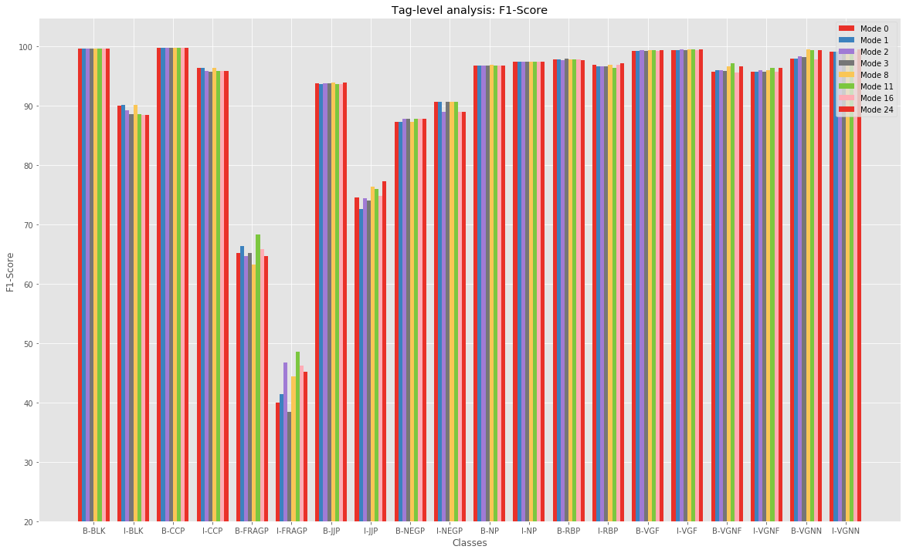

Slide 17


As in the above graphs it can be seen that, the performance of the tags FRAGP and NEGP are very staggering.
The main reason for this error is that the probability of predicting a sequence to be NP or NP + FRAGP becomes quite similar in many cases and thus, it becomes hard to get the correct chunk tag.
Similarly is the case with NEGP, which in general combines with verb groups to form VGNF however due to presence of NP in between it is not possible and is often grouped with others.

Slide 18
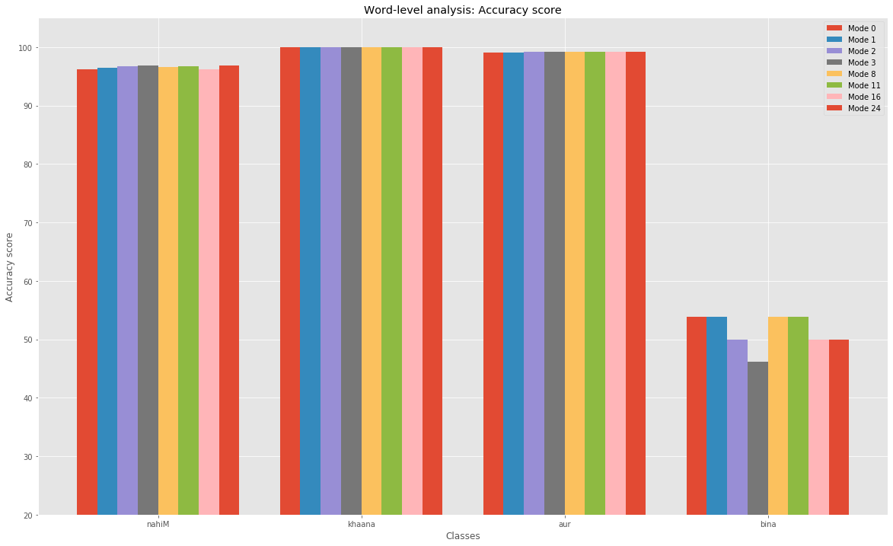
8.3 Word Level Analysis

Slide 19
In this level of analysis, we understand how our model behaves for various words. Since our corpus is very large so we will focus only certain words where the tags for the word have not been predicted well by the model.
‘binA’ : In general this takes the NEG tag and combines with the verb group to form VGNF, however when some noun appears in between it is not able to form group with the verb and is tagged as NEGP. However, sometimes it is treated as part of NP which results in bad results for the word.
On the other hand, words like ‘khaana’ and ‘aur’ show very good results as they don’t face the above problem and they have more or less the same chunk tag in every situation.

Slide 20
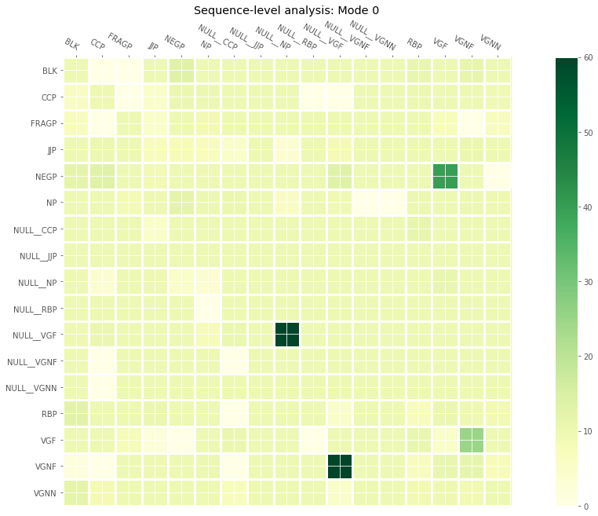
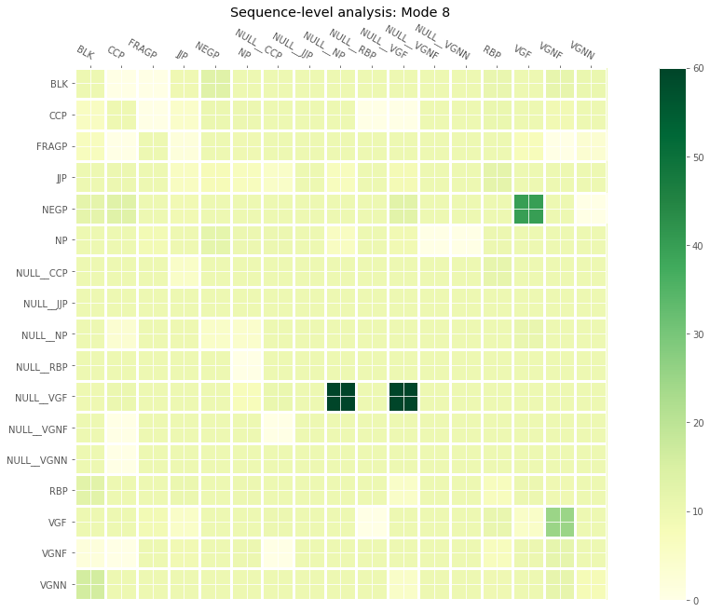
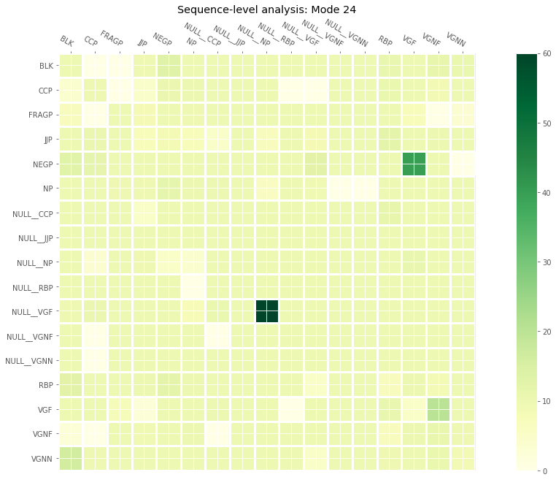
8.4 Sentence Level Analysis
Comparison of prediction of chunk tag sequence pairs for different mode

Slide 21
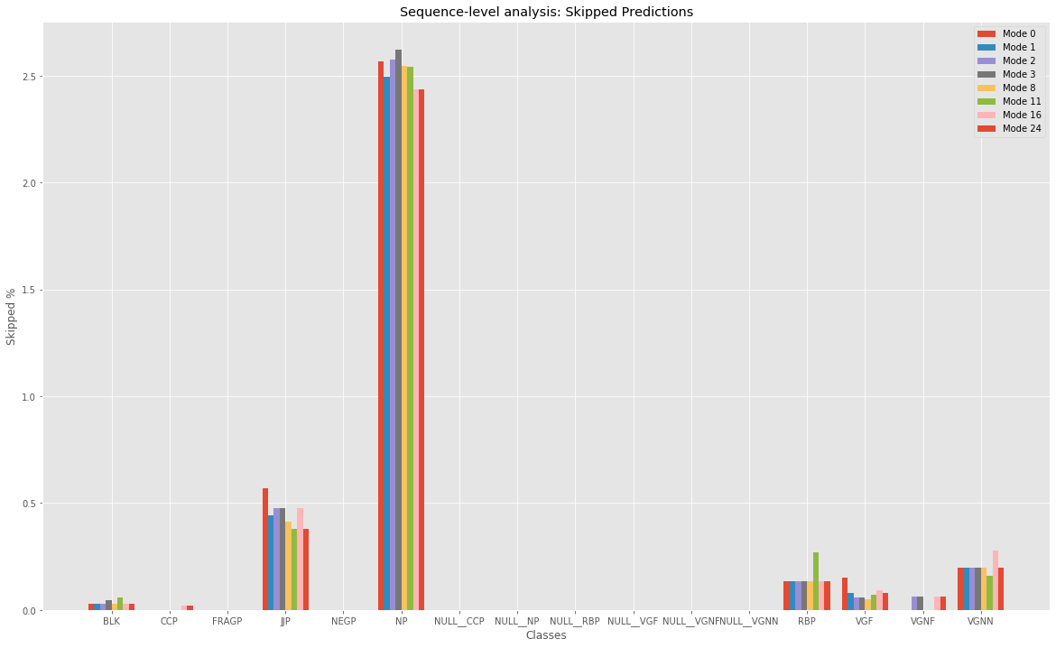
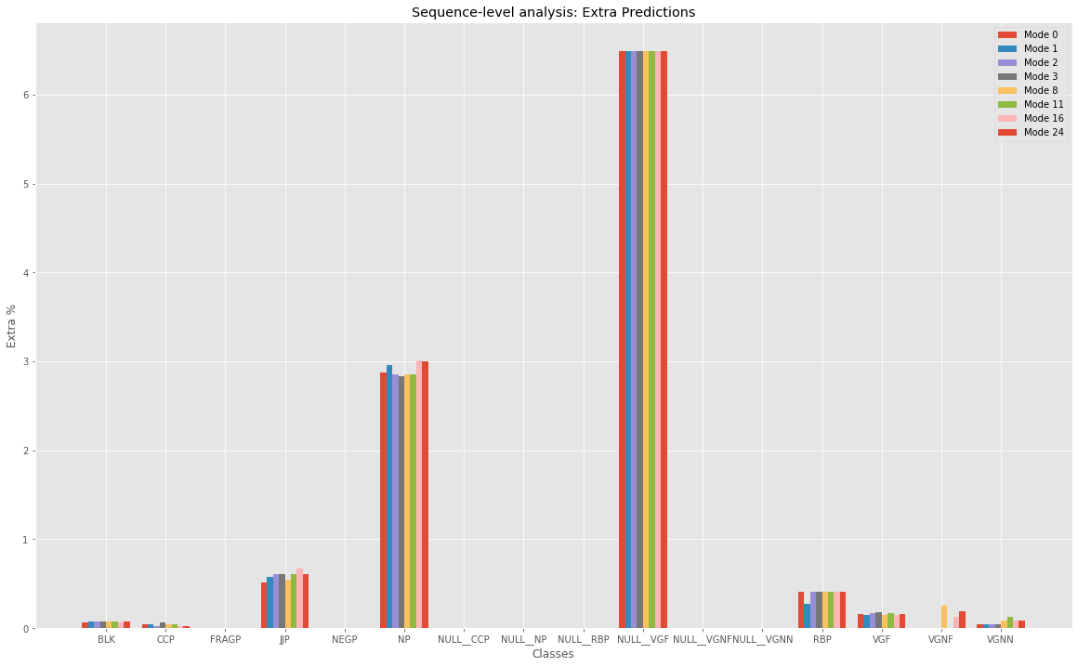
8.5 Chunk Boundary Analysis

Slide 22
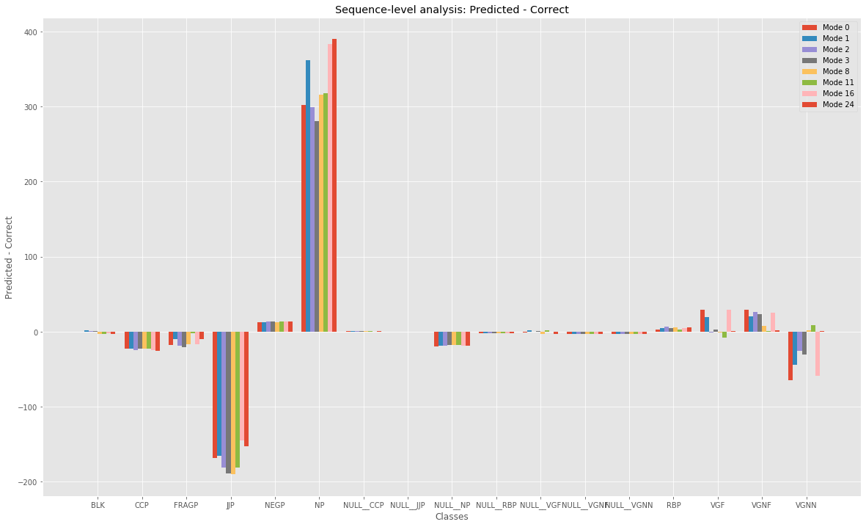
Comparison of Predicted and Correct boundaries

Slide 23
9. CONCLUSION:
After doing error analysis on various levels we come to the conclusion that, there occurs pattern in the dataset which are more prone to error, and certain feature sets perform distinctly better than the others.
Predicting NP <-> NP + FRAGP is a very common error that occurs. Apart from that, prediction of NEGP tag is also error prone.
Use of ‘case’ in the feature set shows better results in prediction of the results. Suffixes can also play a role in predicting the values correctly.
Some words like ‘binA’ are not predicted that well by the model.
At many places, NP and JJP boundaries are both skipped and created(extra). Although overall sequence order is maintained but such errors occur much more frequently.

Slide 24
THANK YOU

